Slide 1
DATA 468. Applied Stochastic Process
by
Dr. Zakir
Department of Mathematics University of Arizona
Email. zakir@arizona.edu

Slide 2
Outline
Using the Law of Total Probability with Recursion
Absorption Probabilities
Mean Hitting Times
Mean Return Times
3
4

Slide 3
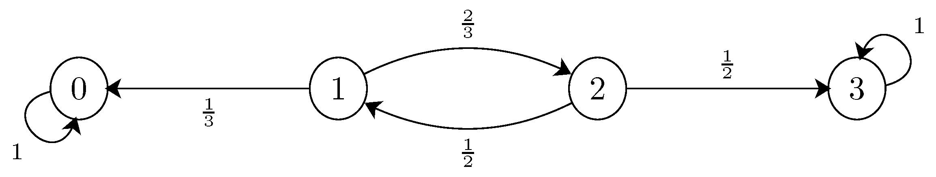
Using the Law of Total Probability with Recursion
A very useful technique in the analysis of Markov chains is using law of total probability.
We will use this technique to find absorption probabilities, mean hitting times, and mean return times for the following Markov china.
The probability of any event is between 0 and 1
The sum of the probabilities of all possible outcomes is 1
Complementary events are mutually exclusive.
Notes:
https.//www.probabilitycourse.com/chapter11/11_2_5_using_the_law_of_total_probability_with_recursion.php

Slide 4
Outline
Using the Law of Total Probability with Recursion
Absorption Probabilities
Mean Hitting Times
Mean Return Times
3
4

Slide 5
Absorbing state and absorbing Markov Chains
A state is called an absorbing state if, once the chains enters the state, it remains there forever.
The probability of leaving an absorbing state is zero: p_{kk} = 1, and p_{kj} = 0 for j ≠ k.
A Markov chain is called an absorbing chain if
(i) It has at least one absorbing state
(ii) It is possible to go from any non-absorbing state to an absorbing state (perhaps in more than one step).
The non-absorbing states in an absorbing Markov chain are called transient states.
Notes:
https.//www.stat.auckland.ac.nz/~fewster/325/notes/ch1annotated.pdf

Slide 6
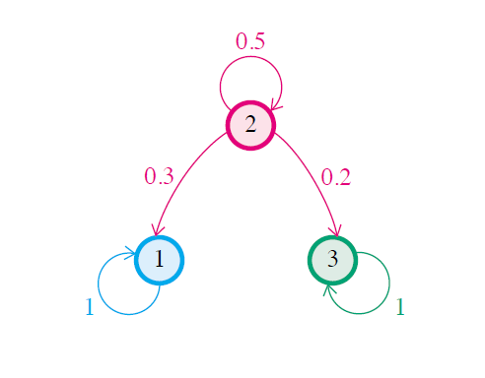
Absorbing Markov Chains:Example1
(i) Solution Since p₁₁=1 and p₃₃=1, both state 1 and state 3 are absorbing states.
(ii) It is possible to go from the non-absorbing state to an absorbing state.
This Markov chain is absorbing.

Slide 7
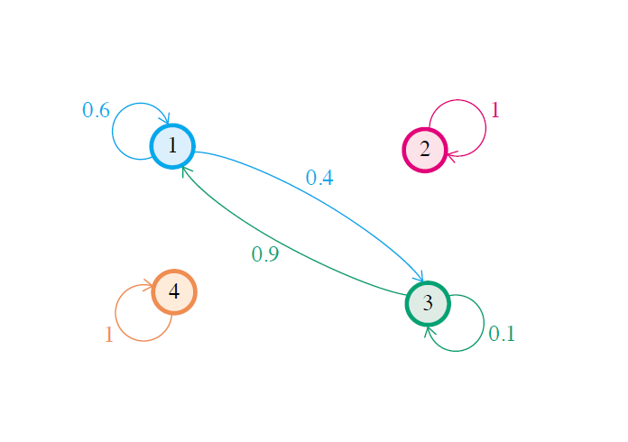
Absorbing Markov Chains:Example1
(i). States 2 and 4 are absorbing, with states 1 and 3 non-absorbing.
(ii). As the transition diagram shows, neither non-absorbing state leads to an absorbing state, so that this Markov chain is non-absorbing.

Slide 8
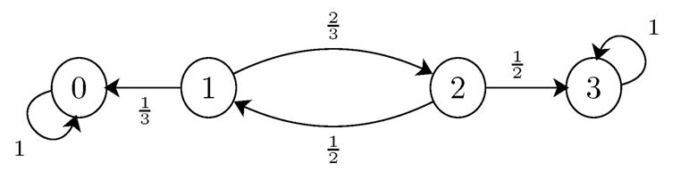
Absorption Probabilities
Let's define a_{i} as the absorption probability in state 0 if we start from state i. More specifically,
a0=P(absorption in 0|X0=0),
a1=P(absorption in 0|X0=1),
a2=P(absorption in 0|X0=2),
a3=P(absorption in 0|X0=3).
We have a₀=1, and a₃=0
To find the values of a₁ and a₂, we apply the law of total probability with recursion.
The main idea is the following: if X_{n}=i, then the next state will be X_{n+1}=k with probability p_{ik}

Slide 9
Absorption Probabilities
Let's now define b_{i} as the absorption probability in state 3 if we start from state i.
Since a_{i}+b_{i}=1, we conclude

Slide 10
Outline
Using the Law of Total Probability with Recursion
Absorption Probabilities
Mean Hitting Times
Mean Return Times
3
4

Slide 11
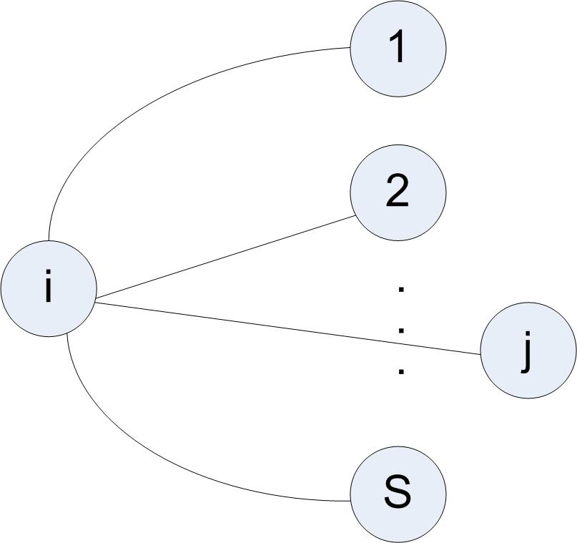
Mean Hitting Times
h_{ij}​: the expected number of steps to reach state j starting from state i, for the first time.
p_{i1}
1+h_{1j}
1+h_{2j}
p_{i2}
p_{ij}
p_{is}
1+h_{sj}
Notes:
https.//www.stat.auckland.ac.nz/~fewster/325/notes/ch1annotated.pdf

Slide 12
Mean Hitting Times: Example
Let's define h_{ij} as the number of steps needed until the chain hits state 0 or state 3, given that X₀=i.
By this definition, we have h₀₀=h₃₃=0.
To find h_{1j} and h_{2j}, we use the law of total probability with recursion as before.
For example, if X₀=1, then after one step, we have X₁=0 or X₁=2. Thus, we can write
Similarly, we can write
Notes:
https.//www.stat.auckland.ac.nz/~fewster/325/notes/ch1annotated.pdf
https://www.probabilitycourse.com/chapter11/11_2_5_using_the_law_of_total_probability_with_recursion.php
https://youtu.be/NXJRR6JPwQ8?si=kon6bieGcwhvpcmA

Slide 13
Mean Hitting Times
Solving equations 1 & 2, we obtain
Generally, let A⊂S be a set of states. The above procedure can be used to find the expected time until the chain first hits one of the states in the set A. so in the current example A={0,3}
Notes:
https://www.probabilitycourse.com/chapter11/11_2_5_using_the_law_of_total_probability_with_recursion.php

Slide 14
Outline
Using the Law of Total Probability with Recursion
Absorption Probabilities
Mean Hitting Times
Mean Return Times
3
4

Slide 15
Mean Return Times:
Another interesting random variable is the first return time. In particular, assuming the chain is in state l, we consider the expected time (number of steps) needed until the chain returns to state l. For example, consider a Markov chain for which X₀=2. If the chain gets the values
Then the first return to state 2 occurs at time n=4. Thus, the first return time to state 2 is equal to 4 for this example. Here, we are interested in the expected value of the first return time. In particular, assuming X₀=l, let's define r_{l} as the expected number of steps needed until the chain returns to state l. To make the definition more precise, let's define
Then

Slide 16
Mean Return Times
Recurrent states are classified into two main types: positive recurrent and null recurrent.
1). Positive Recurrent States:
A positive recurrent state has a finite expected time to return, meaning the chain will return "relatively fast“
2). Null Recurrent States:
A null recurrent state has an infinite expected time to return, meaning the chain will return, but the expected time to do so is unbounded.

Slide 17
Mean Return Times
Consider a finite irreducible Markov chain {X_{n}:n=1, 2, 3,…} with state space S={1,2,3,…r}. Let r_{i} denote the mean return time to sate i, defined as
Where h_{ki} is the expected time until the chain hits state _{i} given that X₀=k expressed as
Notes:
https://www.probabilitycourse.com/chapter11/11_2_5_using_the_law_of_total_probability_with_recursion.php

Slide 18
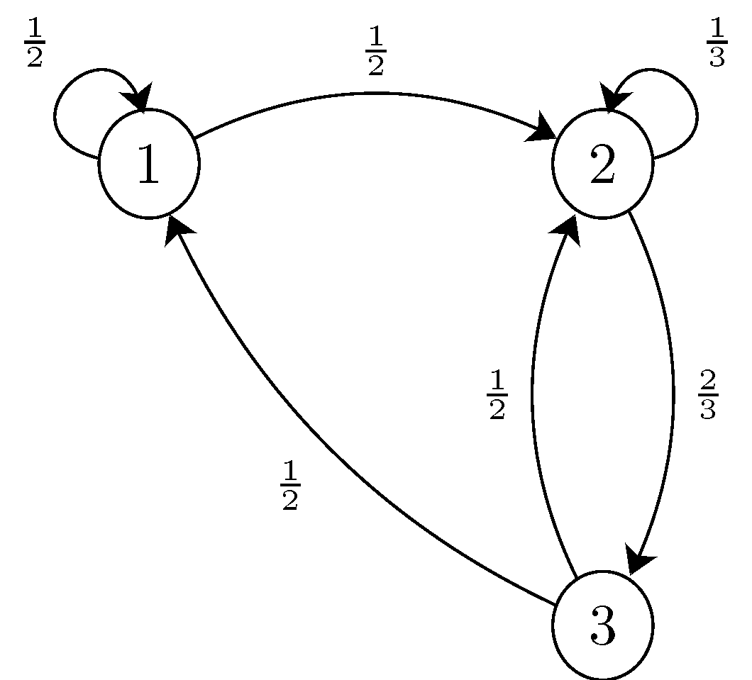
Mean Return Times:
Consider a finite irreducible Markov chain below. Find the mean return time to sate 1.
Let r₁ denote the mean return time to sate 1. Started from sate k, we wish to find the expected number of times until the chain hits sate 1 for the first time expressed as m_{k1}
Notes:
https://www.probabilitycourse.com/chapter11/11_2_5_using_the_law_of_total_probability_with_recursion.php

Slide 19
Mean Return Times: Example
Consider a finite and irreducible Markov chain below. Fin the mean return time to sate 1.
jєS={1,2,3}
h11=0, h21=5, h31=7/2
Notes:
https://www.probabilitycourse.com/chapter11/11_2_5_using_the_law_of_total_probability_with_recursion.php

